Slide 1

Lending Club - Case Study
Created By – Sagar Maru

Slide 2

Planning the Process Data Understanding: Gain insights into the dataset. Data Cleaning and Manipulation: Prepare and refine the data for analysis. Data Analysis and Visualization: Analyze the data and create visual representations to uncover insights
.
Data Understanding
Data Cleaning
and
Manipulation
Data Analysis
and
Visualization

Slide 3
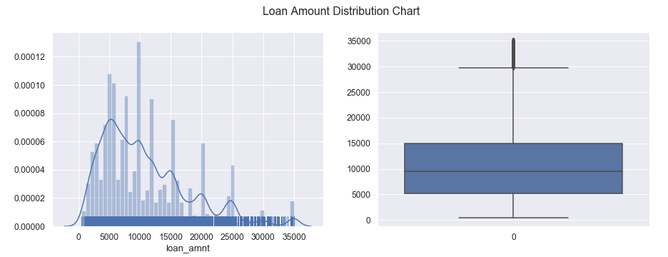
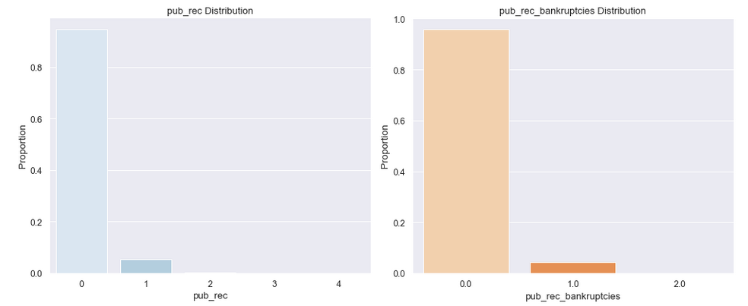
Loan Amount: A substantial number of people took out loans of 9,500, which aligns with the median of the distribution. Loans exceeding 30,000 are relatively rare. Public Records: Additionally, approximately 90% of borrowers have no public derogatory records, and 99% have not declared bankruptcy.

Slide 4
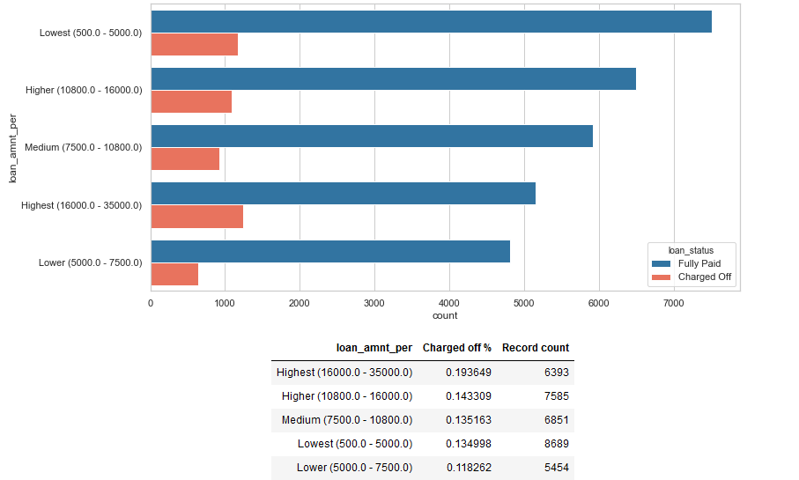
Interest Rate Vs Loan Status
Larger loan amounts are more likely to result in default.
This trend suggests that borrowers with higher loan balances face a greater risk of non-repayment, indicating a direct correlation between the loan size and the likelihood of default.

Slide 5
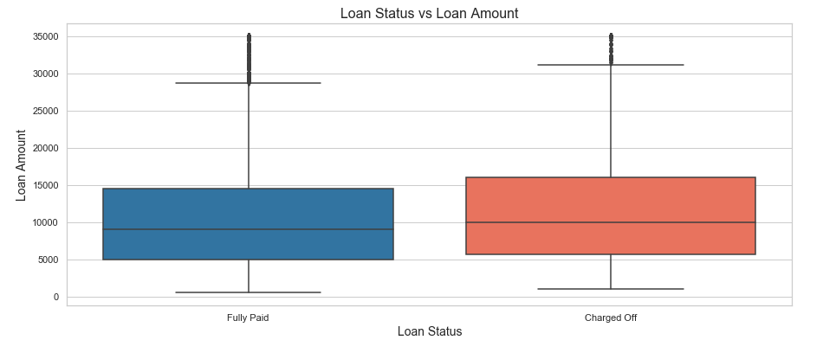
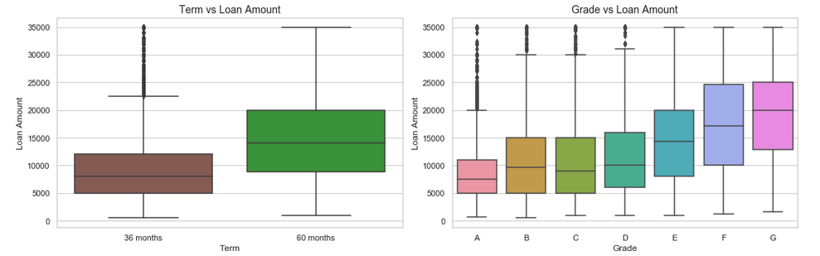
Charged Off loans typically have higher amounts than Fully Paid ones, suggesting larger loans are more prone to default. Higher loan amounts often correspond with longer tenures, especially 60 months. Borrowers with grades 'F' and 'G' tend to take the largest loans, with amounts increasing from grade A to G.

Slide 6
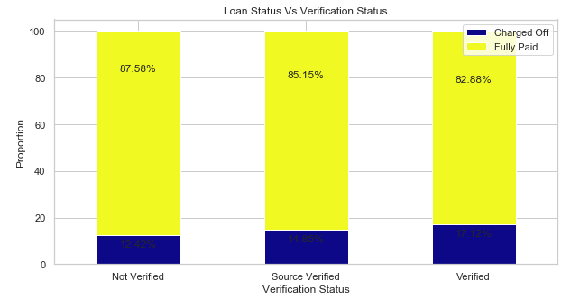
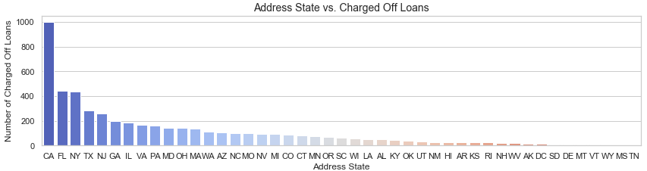
Verification Status:
Interestingly, verified applicants have a higher default rate, indicating potential flaws in the verification process. Surprisingly, borrowers with unverified incomes are more likely to repay fully.
Address State:
The highest defaults occurred in CA, FL, and NY, followed by TX and NJ, highlighting regional differences in loan performance and higher risk in these states.

Slide 7
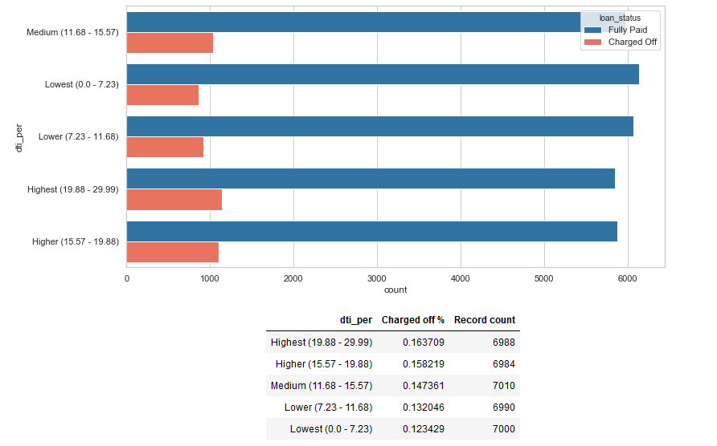
A higher Debt-to-Income (DTI) ratio is linked to a higher percentage of charged-off loans. As borrowers accumulate more debt relative to their income, the risk of default increases, highlighting DTI as a crucial factor in evaluating loan repayment capability.
Debt-to-Income (DTI) Ratio Vs Loan Status

Slide 8
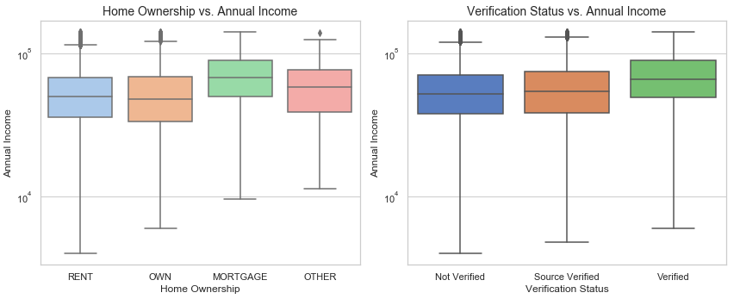
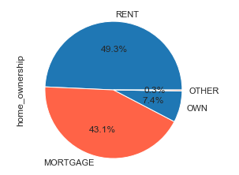
Individuals with mortgages typically have higher annual incomes compared to other home ownership statuses.
Higher-income borrowers are also more likely to have verified income sources, indicating a strong link between mortgage ownership, income verification, and income levels. These insights highlight the relationship between home ownership status and financial verification.

Slide 9
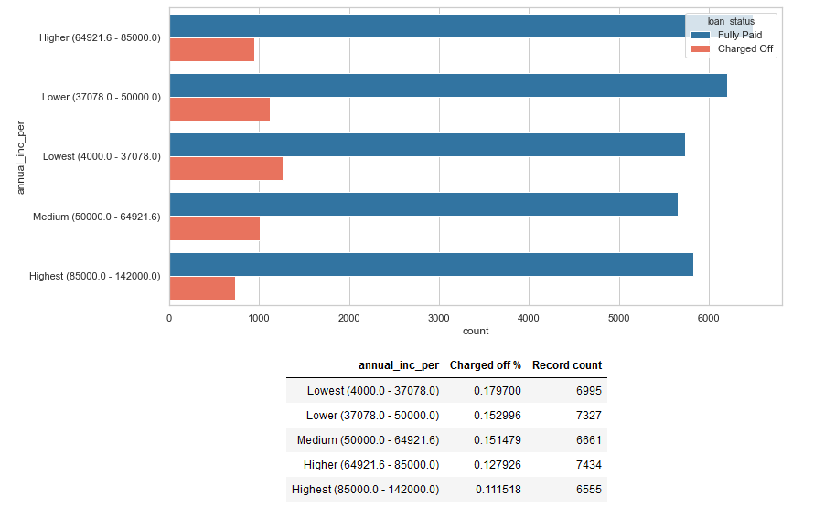
Higher income levels are linked to better repayment rates, making defaults less likely. Conversely, lower income levels increase the chances of loan defaults. This highlights the significant role income plays in repayment behavior, with higher income reducing the risk of default.
Annual Income Vs Loan Status

Slide 10
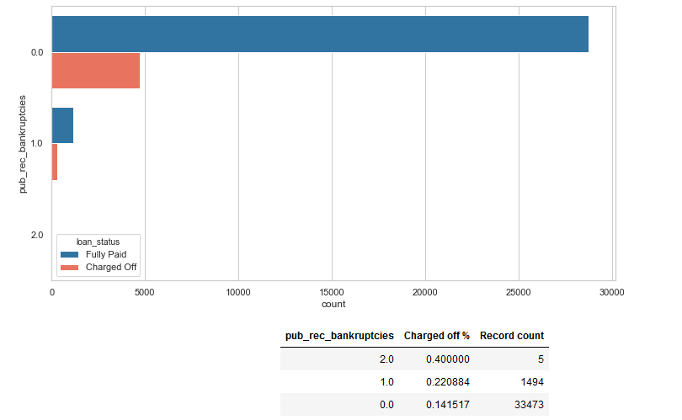
public bankruptcy records Vs Loan Status
A higher number of public bankruptcy records significantly increases the risk of loan default.
More records suggest a greater likelihood of non-repayment, making this an important factor in evaluating loan risk.

Slide 11
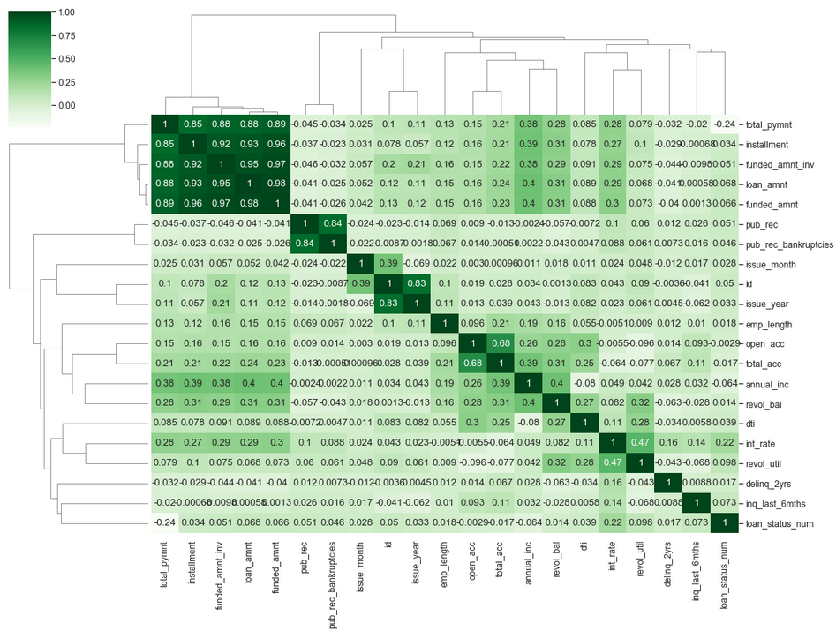
Darker values indicate stronger correlations. Loan_amnt, funded_amnt, funded_amnt_inv, installment, and total_pymnt are highly correlated, showing strong relationships. Additionally, public records (pub_rec, pub_rec_bankruptcies) and account-related fields (open_acc, total_acc) exhibit significant correlation, indicating these variables are closely connected and may influence each other within the dataset.

Slide 12
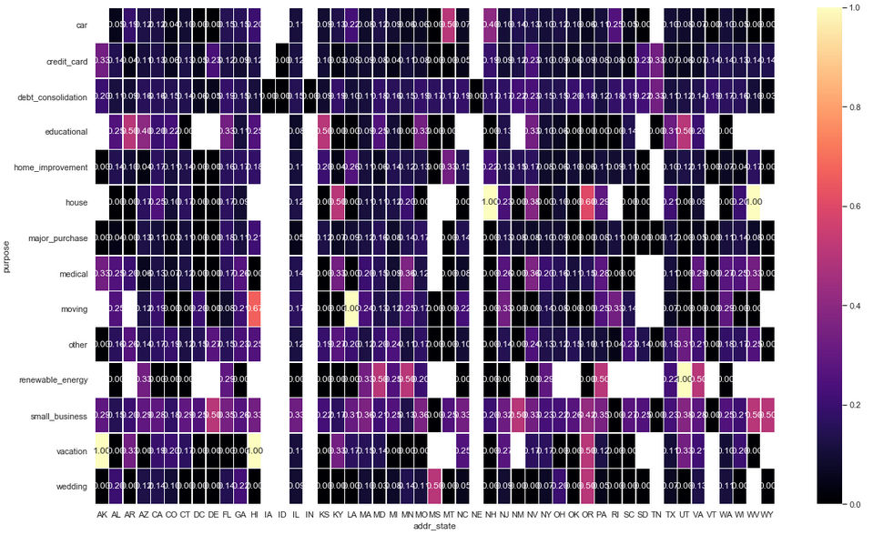
Vacation Loans: Higher risk is observed in states such as Alaska (AK), Hawaii (HI), and Oregon (OR).
Education Loans: Elevated risk is noted in Arkansas (AR), Kansas (KS), and Utah (UT).
Small Business Loans: Delaware (DE), New Mexico (NM), West Virginia (WV), and Wyoming (WY) show higher risks for small business loans.
Wedding Loans: Increased risk is observed in Mississippi (MS) and Oregon (OR).

Slide 13

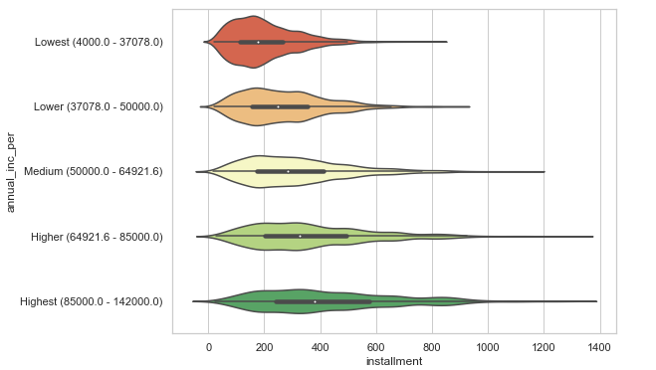
Higher installment amounts are linked to more defaults across all income groups, indicating that as payments increase, the likelihood of loan defaults rises, regardless of income level.

Slide 14

Thank you
From – Sagar Maru

